Slide 1
4th Sep 2023
Azure Storage Account
Redundancy
Locally Redundant Storage
Geo Redundant storage
Zone redundant storage
Geo-zone redundant storage
Service level agreement
Cross tenant replication
Access tiers
Hot
Cool
ADLS Gen2
Azure file sharing
Tables
Queues
Azure pricing calculator

Slide 2
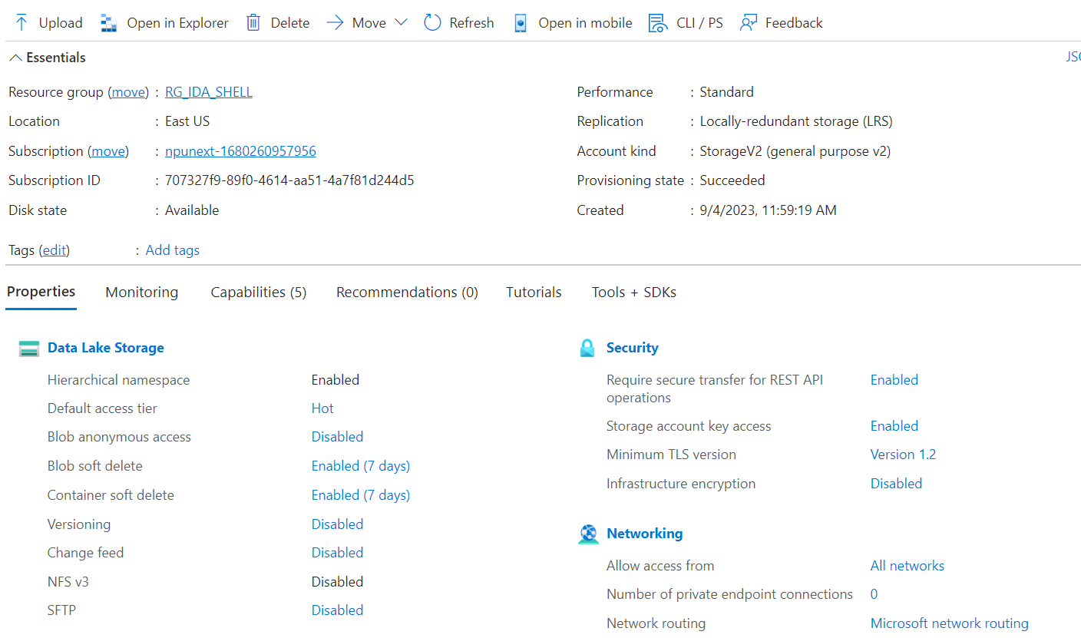
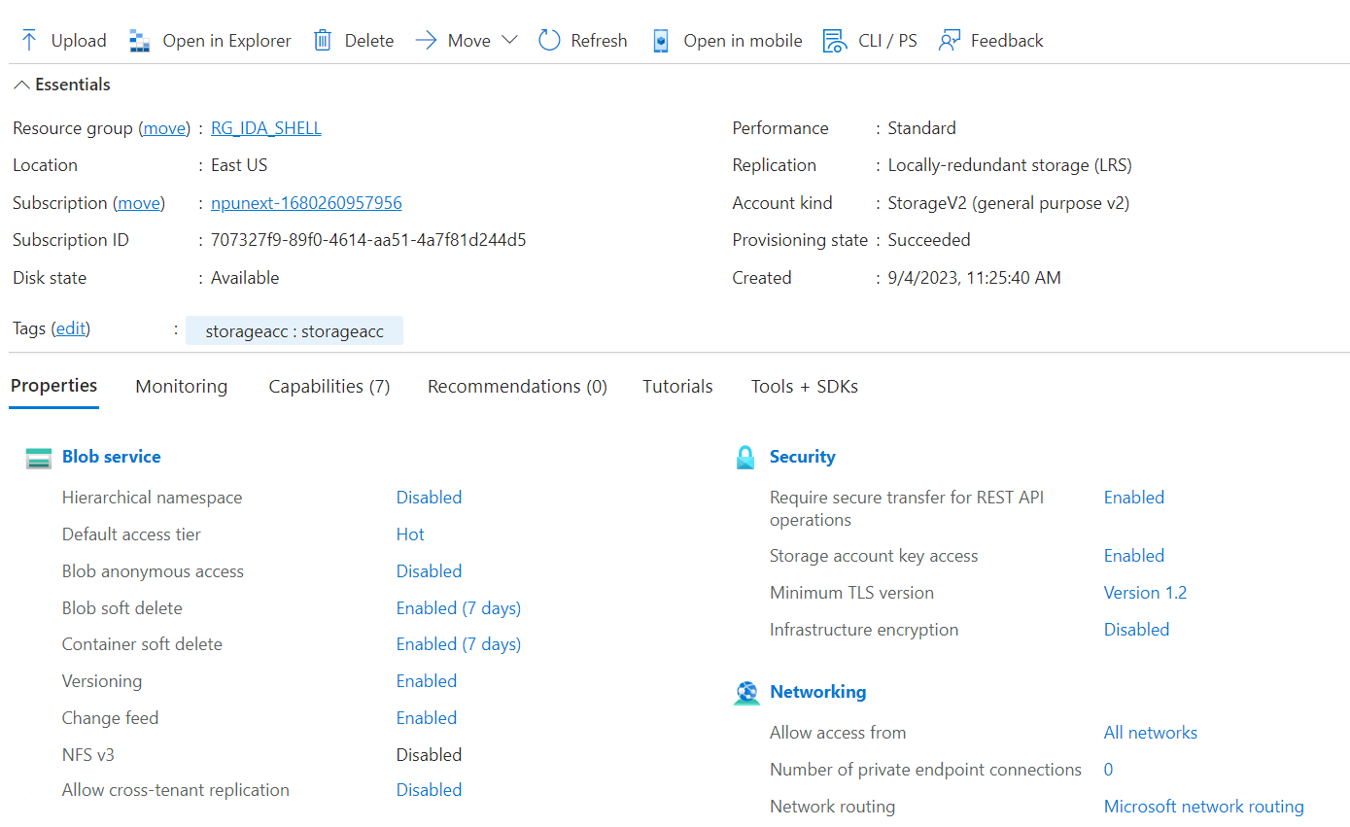

Slide 3
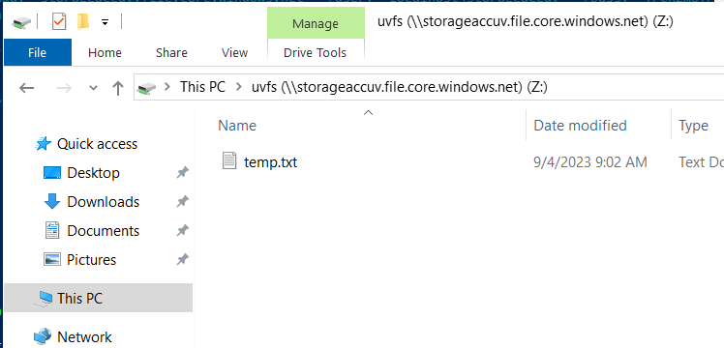
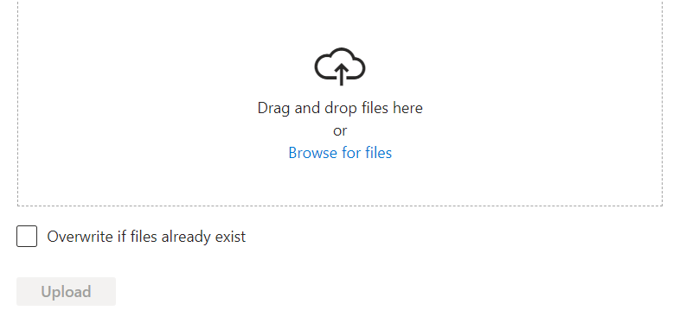
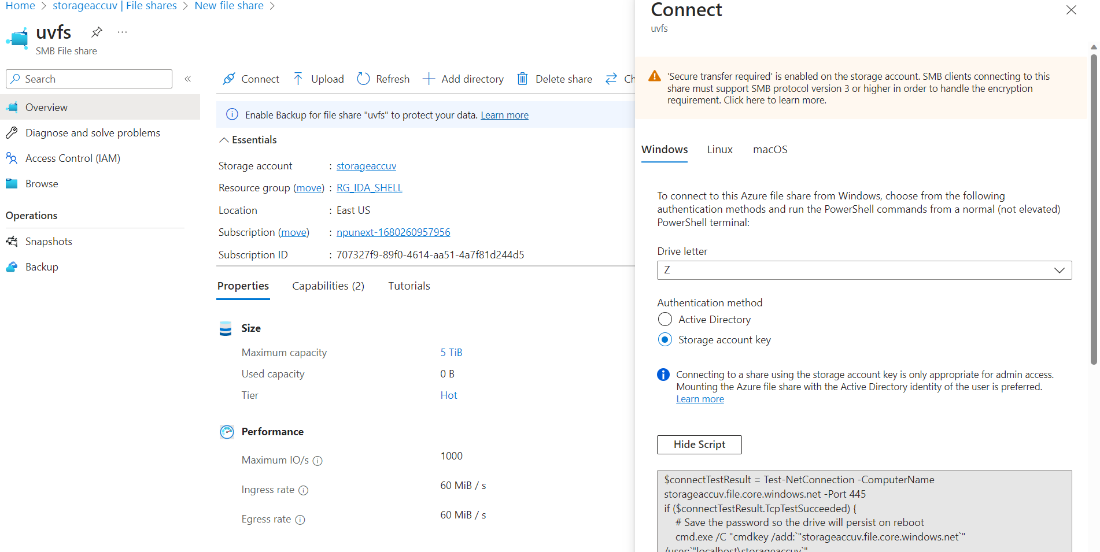
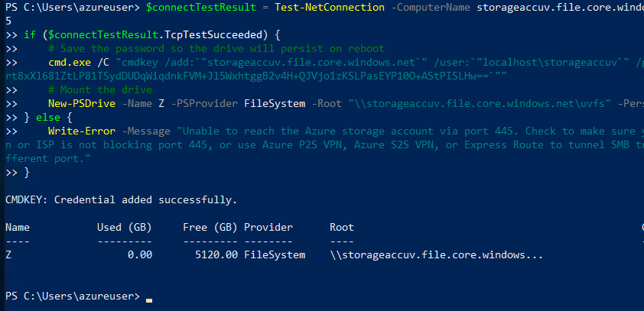

Slide 4
5th Sep 2023
Data Factory
Shared access signature
Access keys
Key Vault
Secrets
IAM
RBAC
Azure data factory
ETL, ELT
Activities
Integration runtimes
Auto resolved
Self hosted
Azure SSIS

Slide 5
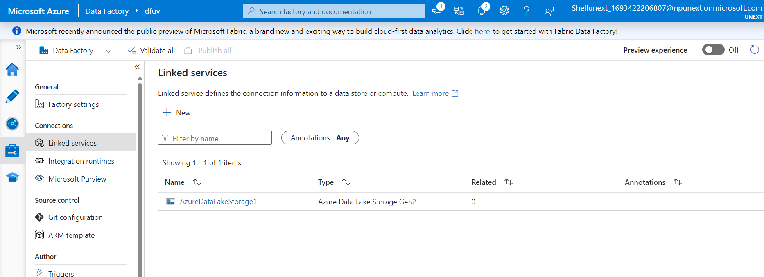
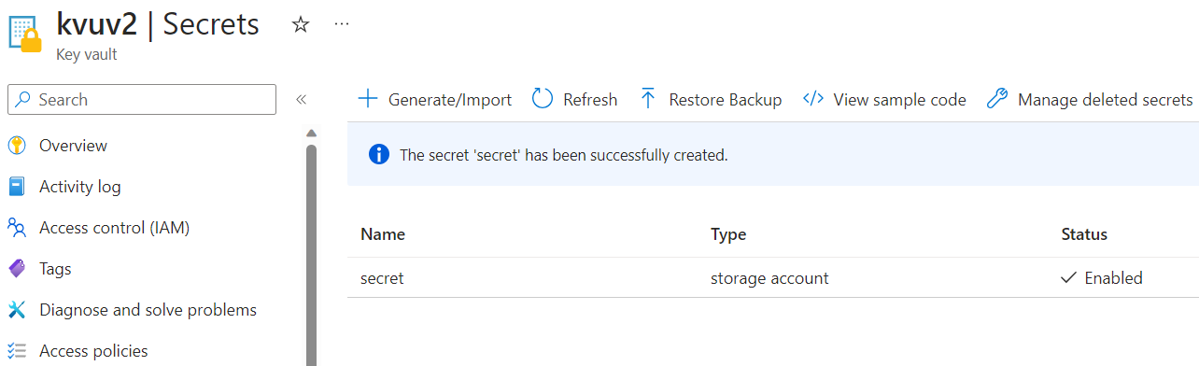
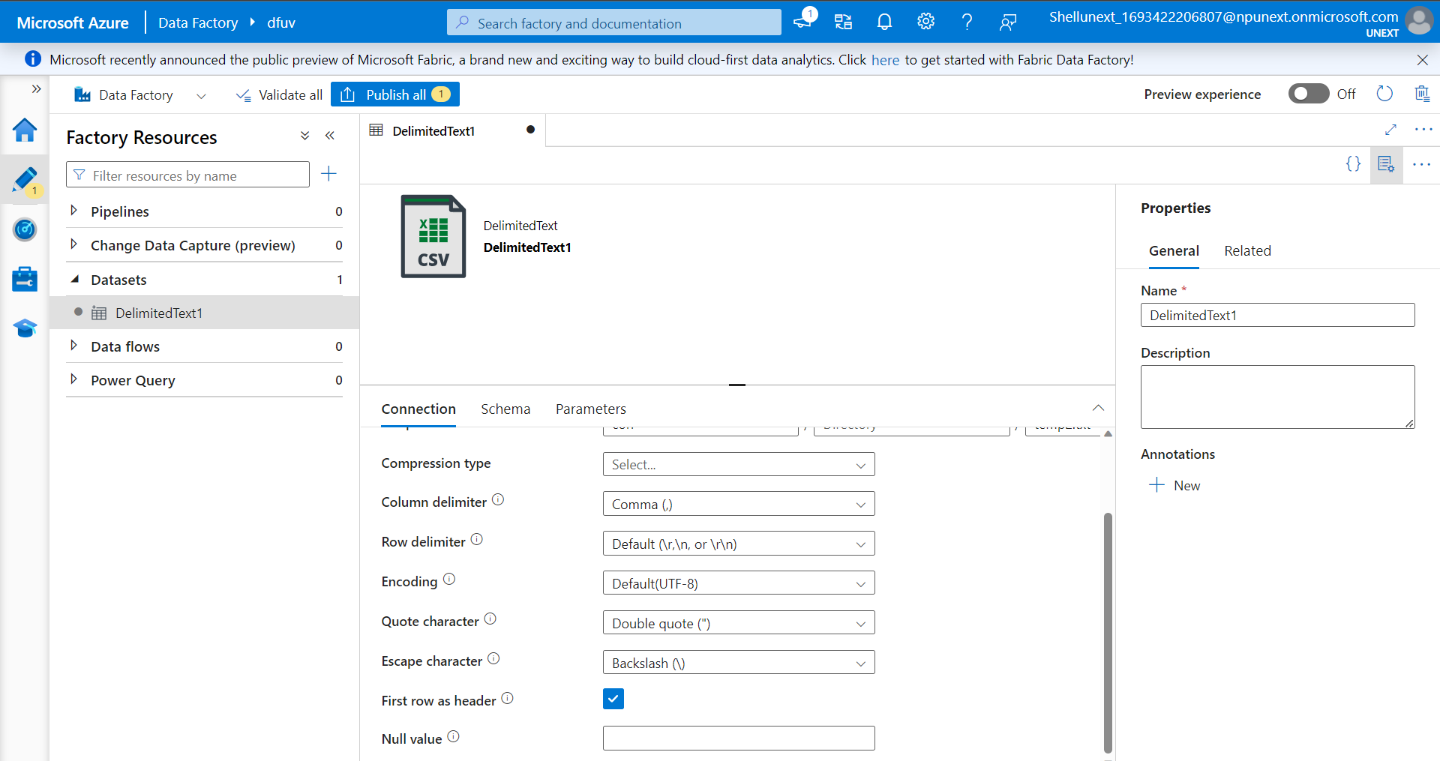
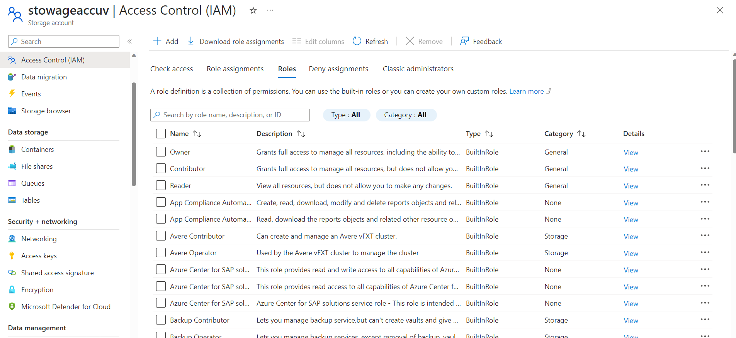

Slide 6
6th Sep 2023
Azure data factory pipelines
Variables
Activities
Delete
Execute pipeline
Fail
Get metadata
Lookup
Stored procedures
Script
WebHook
Pipelines to copy data
Monitoring pipeline runs
Triggers
Schedule trigger
tumbling window trigger
Event based trigger

Slide 7
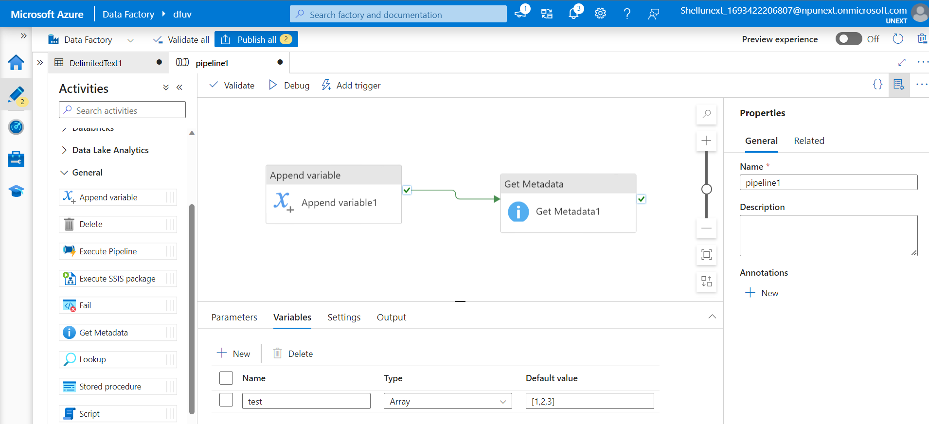
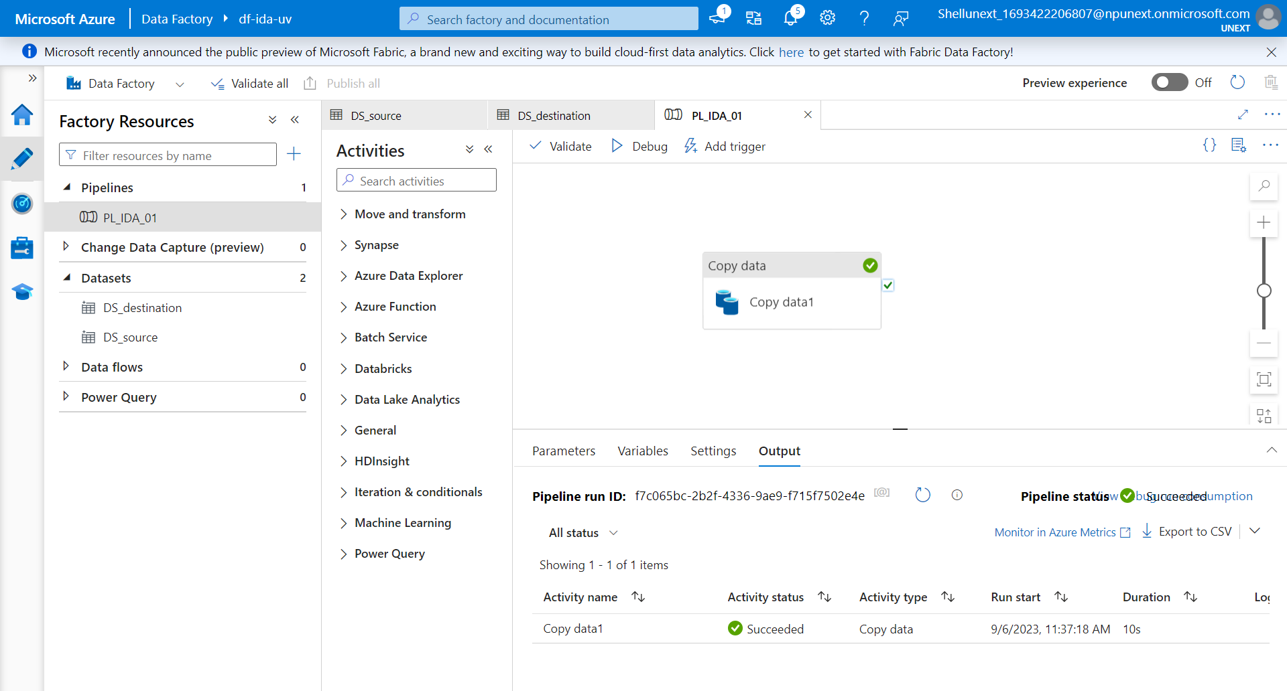
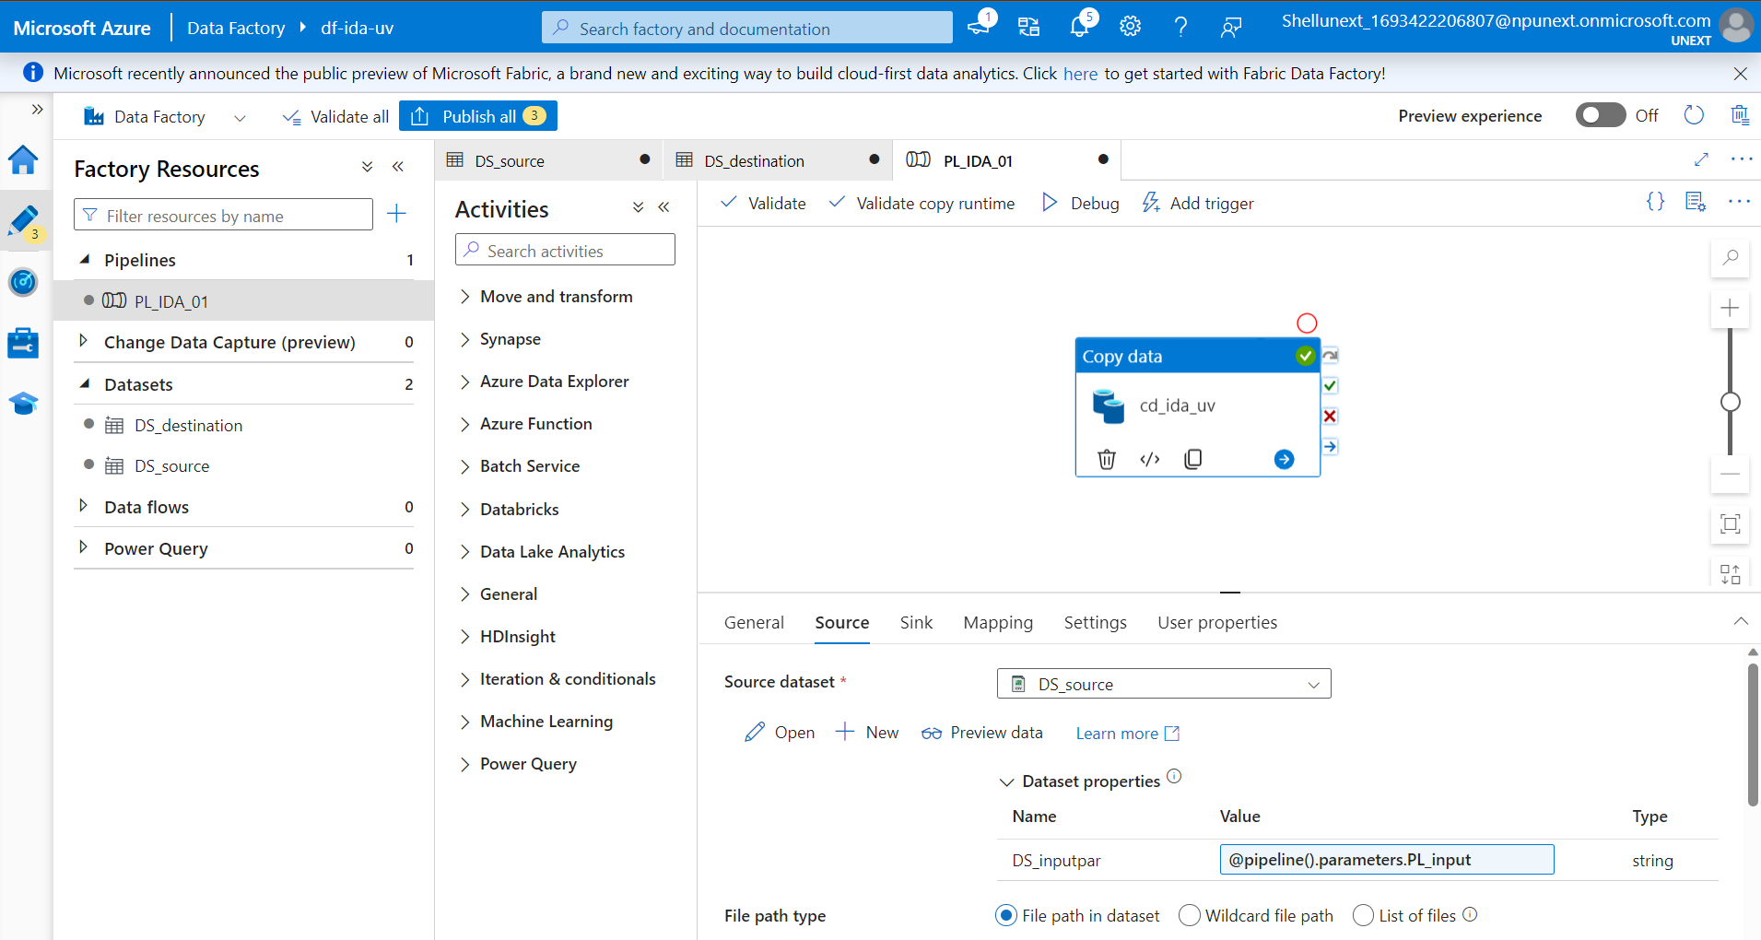
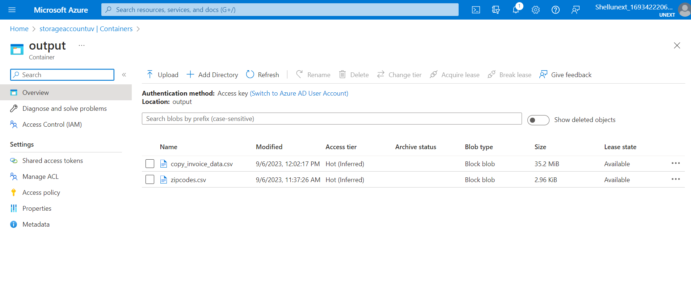

Slide 8
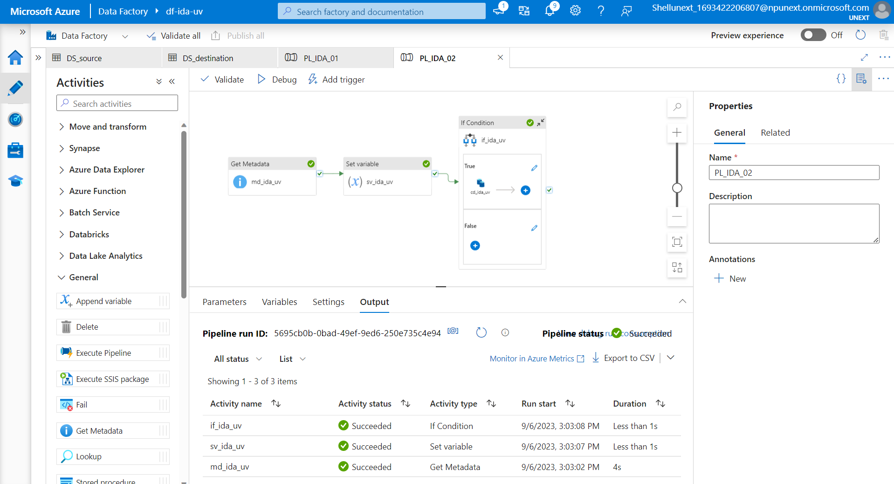
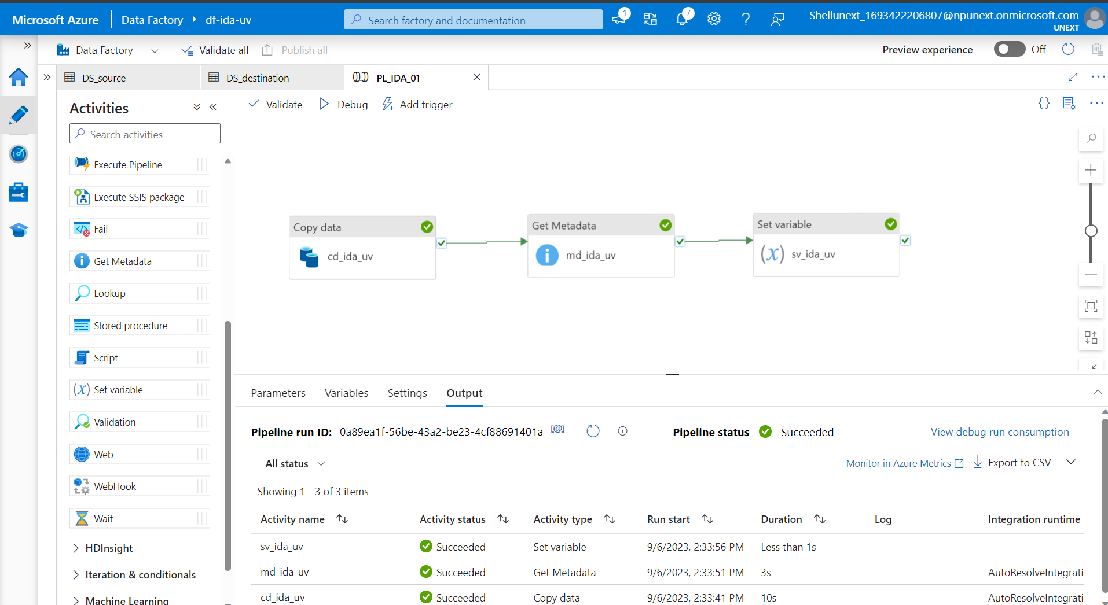

Slide 9
7th Sep 2023
Blob storage accounts
ADLS Gen2 storage accounts
Data factories
For each activity
Data flow activity
Get metadata activity
WebHook activity
Basic transformations
Join
Split
Exists
Lookup
Derived column
Aggregate
Filter
sort

Slide 10
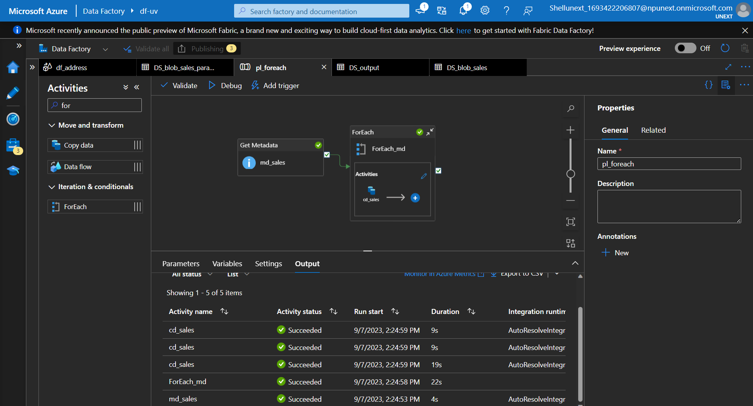
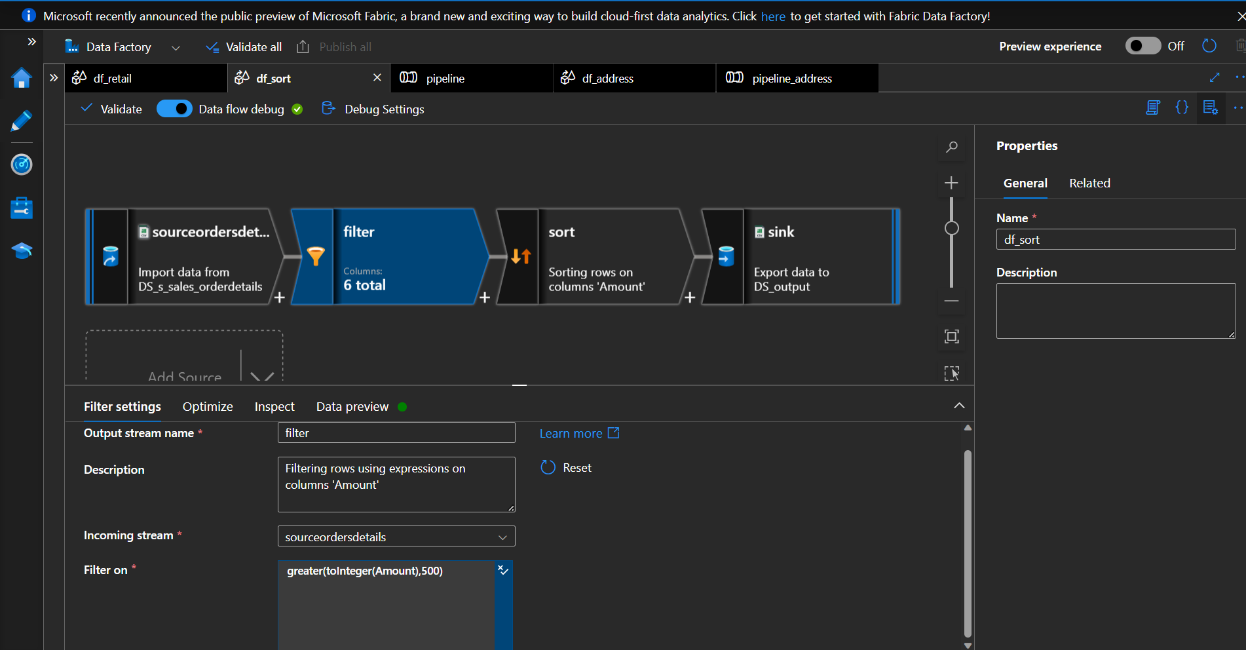
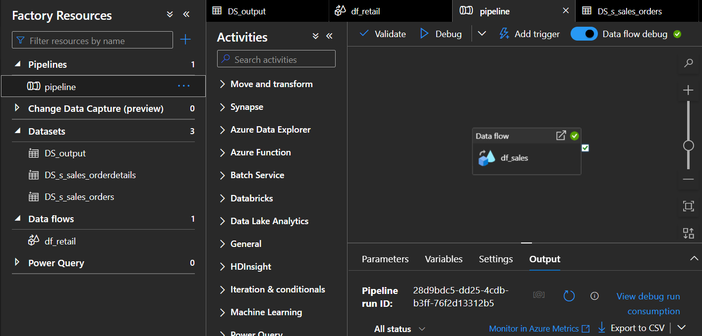
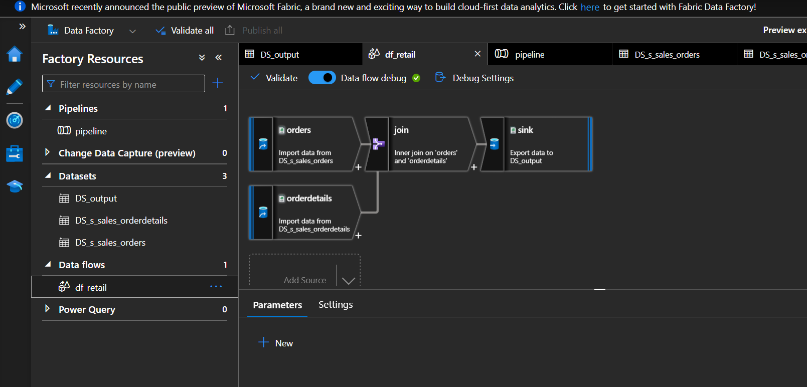

Slide 11
8th Sep 2023
SQL database + sample data
Creating Gen2 storage account
Linked service for azure SQL DB
Look up activity
Copying data from azure SQL DB to block storage
Change data capture
Schema drift
Automation Runbooks
Powershell
Powershell workflow
Python
Graphical
Graphical powershell workflow
Monitor
Metrics
Alerts

Slide 12
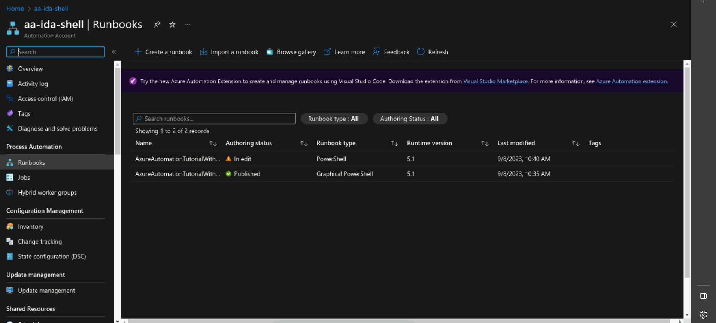
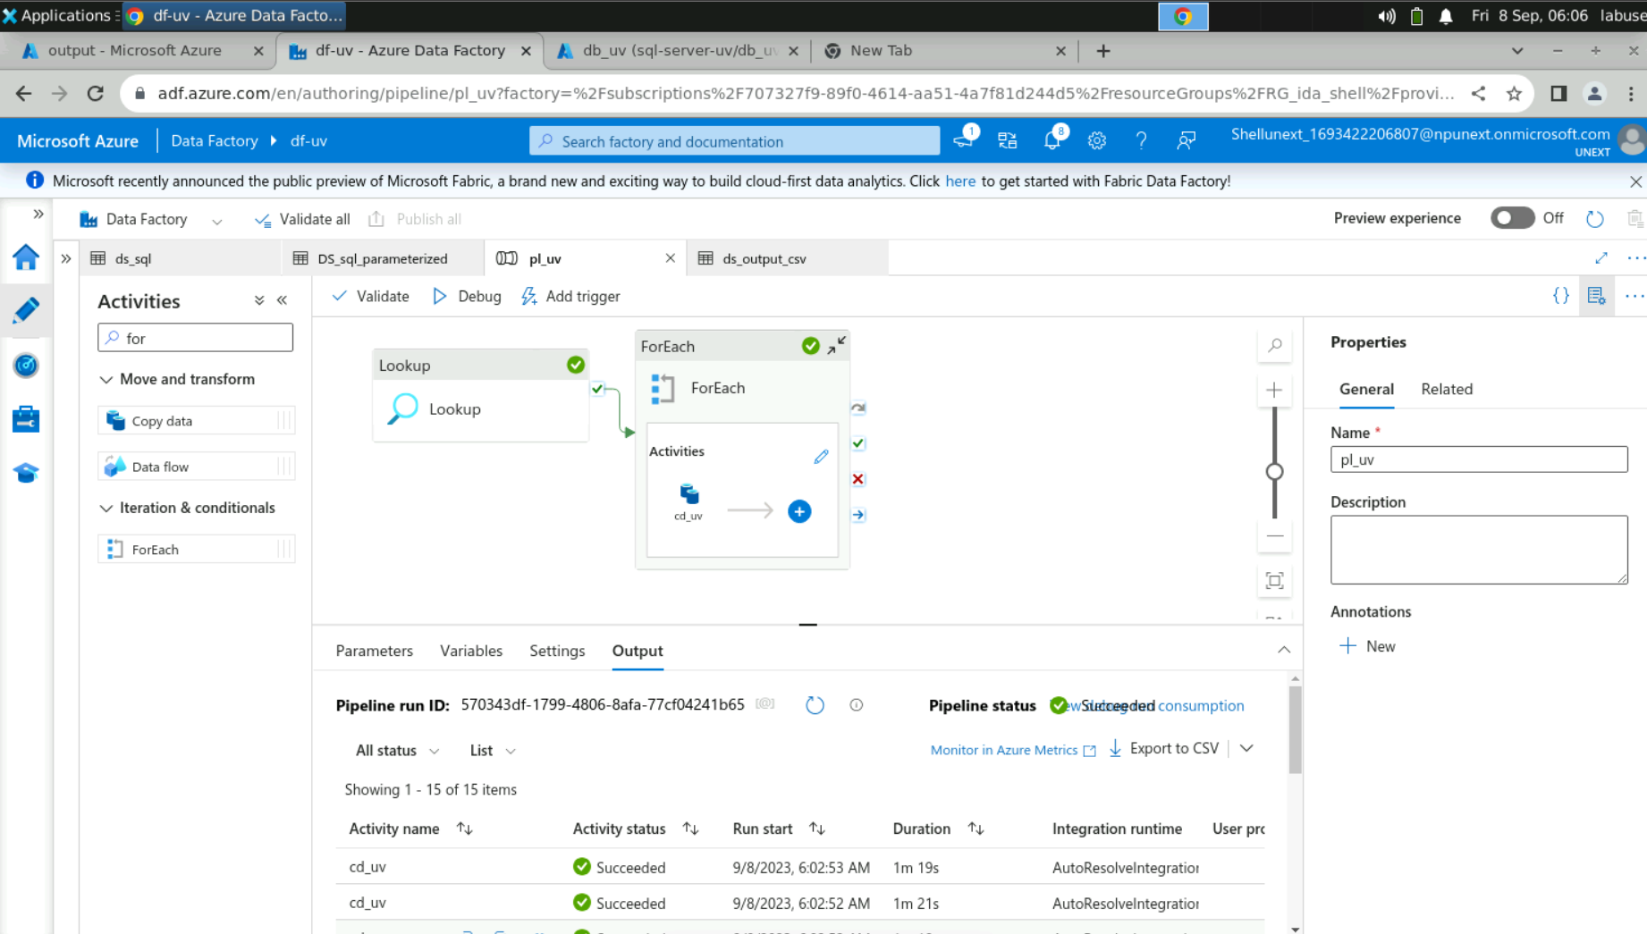
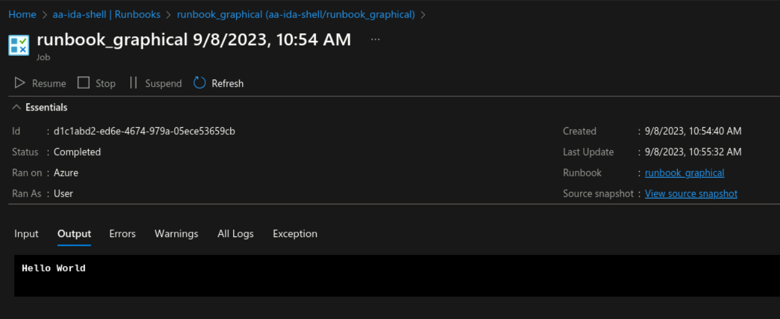

Slide 13
